Slide 1
BUSINESS INTELLIGENCE Visualization
By Ahmad Mousa

Slide 2

Notes:
1.1 - temp

Slide 3


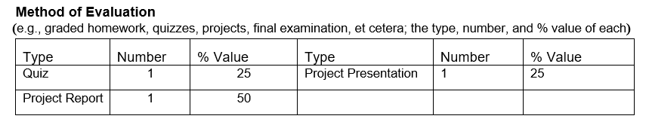

Slide 4
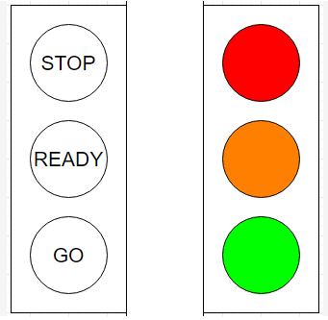
A good data visualization:
It meets the audience’s needs.
It communicates clearly and simply.(H.R. having several simple graphs is better to have one complex graph)
It provides a gradual learning curve.
It adds value to the data.
It tells the truth.

Slide 5
Data as Storytelling
U.S. Debt as Percentage of Gross Domestic Product, 1790–2011
1790 | 29,6% | 1835 | 0.0 | 1880 | 18.4 | 1925 | 21.6 |  | 1970 | 28.0
1791 | 29.2 | 1836 | 0,0 | 1881 | 16.8 | 1926 | 19.0 |  | 1971 | 28.1
1792 | 28.0 | 1837 | 0.2 | 1882 | 14.3 | 1927 | 18.0 |  | 1972 | 27.4
1793 | 24.4 | 1838 | 0.6 | 1883 | 13.5 | 1928 | 17.0 |  | 1973 | 26.0
1794 | 21.8 | 1839 | 0.2 | 1884 | 13.3 | 1929 | 14.9 |  | 1974 | 23.9
1795 | 18.7 | 1840 | 0.3 | 1885 | 13.2 | 1930 | 16.5 |  | 1975 | 25.3
1796 | 16.4 | 1841 | 0.8 | 1886 | 12.4 | 1931 | 22.3 |  | 1976 | 27.5
1797 | 16.5 | 1842 | 1.2 | 1887 | 11.2 | 1932 | 34.5 |  | 1977 | 27.8
1798 | 16.0 | 1843 | 1.5 | 1888 | 10.2 | 1933 | 39.1 |  | 1978 | 27.4
1799 | 15.8 | 1844 | 1.0 | 1889 | 8.6 | 1934 | 44.0 |  | 1979 | 25.6
1800 | 15.1 | 1845 | 0.7 | 1890 | 7.8 | 1935 | 42.9 |  | 1980 | 26.1
1801 | 13.3 | 1846 | 1.2 | 1891 | 7.0 | 1936 | 43.0 |  | 1981 | 25.8
1802 | 13.9 | 1847 | 1.7 | 1892 | 6.6 | 1937 | 40.1 |  | 1982 | 28.7
1803 | 14.1 | 1848 | 2.2 | 1893 | 6.8 | 1938 | 42.8 |  | 1983 | 33.1
1804 | 13.2 | 1849 | 2.5 | 1894 | 7.9 | 1939 | 43.0 |  | 1984 | 34.0
1805 | 10.9 | 1850 | 2.3 | 1895 | 7.9 | 1940 | 42.7 |  | 1985 | 26.4
1806 | 10.0 | 1851 | 2.4 | 1896 | 8.5 | 1941 | 43.3 |  | 1986 | 38.5
Data: Congressional Budget Office

Slide 6
Data as Storytelling
U.S. Debt as Percentage of Gross Domestic Product, 1790–2011
1790 | 29,6% | 1835 | 0.0 | 1880 | 18.4 | 1925 | 21.6 |  | 1970 | 28.0
1791 | 29.2 | 1836 | 0,0 | 1881 | 16.8 | 1926 | 19.0 |  | 1971 | 28.1
1792 | 28.0 | 1837 | 0.2 | 1882 | 14.3 | 1927 | 18.0 |  | 1972 | 27.4
1793 | 24.4 | 1838 | 0.6 | 1883 | 13.5 | 1928 | 17.0 |  | 1973 | 26.0
1794 | 21.8 | 1839 | 0.2 | 1884 | 13.3 | 1929 | 14.9 |  | 1974 | 23.9
1795 | 18.7 | 1840 | 0.3 | 1885 | 13.2 | 1930 | 16.5 |  | 1975 | 25.3
1796 | 16.4 | 1841 | 0.8 | 1886 | 12.4 | 1931 | 22.3 |  | 1976 | 27.5
1797 | 16.5 | 1842 | 1.2 | 1887 | 11.2 | 1932 | 34.5 |  | 1977 | 27.8
1798 | 16.0 | 1843 | 1.5 | 1888 | 10.2 | 1933 | 39.1 |  | 1978 | 27.4
1799 | 15.8 | 1844 | 1.0 | 1889 | 8.6 | 1934 | 44.0 |  | 1979 | 25.6
1800 | 15.1 | 1845 | 0.7 | 1890 | 7.8 | 1935 | 42.9 |  | 1980 | 26.1
1801 | 13.3 | 1846 | 1.2 | 1891 | 7.0 | 1936 | 43.0 |  | 1981 | 25.8
1802 | 13.9 | 1847 | 1.7 | 1892 | 6.6 | 1937 | 40.1 |  | 1982 | 28.7
1803 | 14.1 | 1848 | 2.2 | 1893 | 6.8 | 1938 | 42.8 |  | 1983 | 33.1
1804 | 13.2 | 1849 | 2.5 | 1894 | 7.9 | 1939 | 43.0 |  | 1984 | 34.0
1805 | 10.9 | 1850 | 2.3 | 1895 | 7.9 | 1940 | 42.7 |  | 1985 | 26.4
1806 | 10.0 | 1851 | 2.4 | 1896 | 8.5 | 1941 | 43.3 |  | 1986 | 38.5
The Great Depression & World War II
Reagan Tax Cuts
Data: Congressional Budget Office

Slide 7
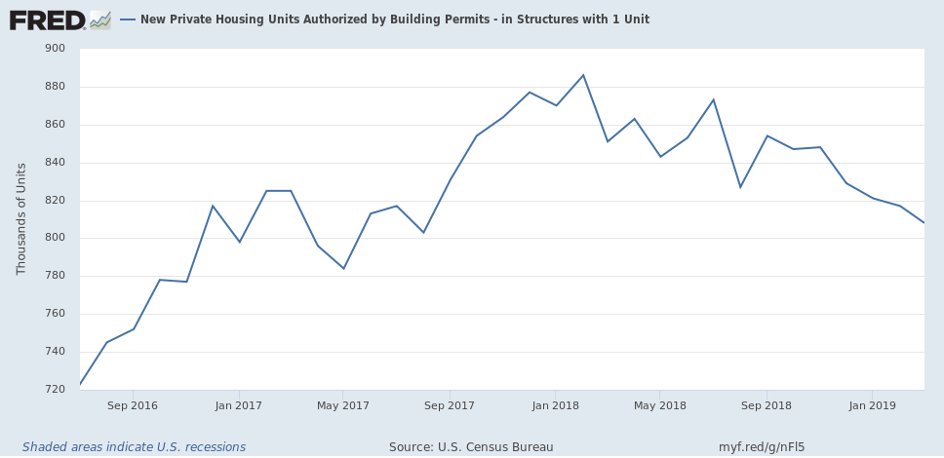
Data = Drama
New Housing Construction: Making A Bottom, At Close To Recessionary Levels
https://seekingalpha.com

Slide 8
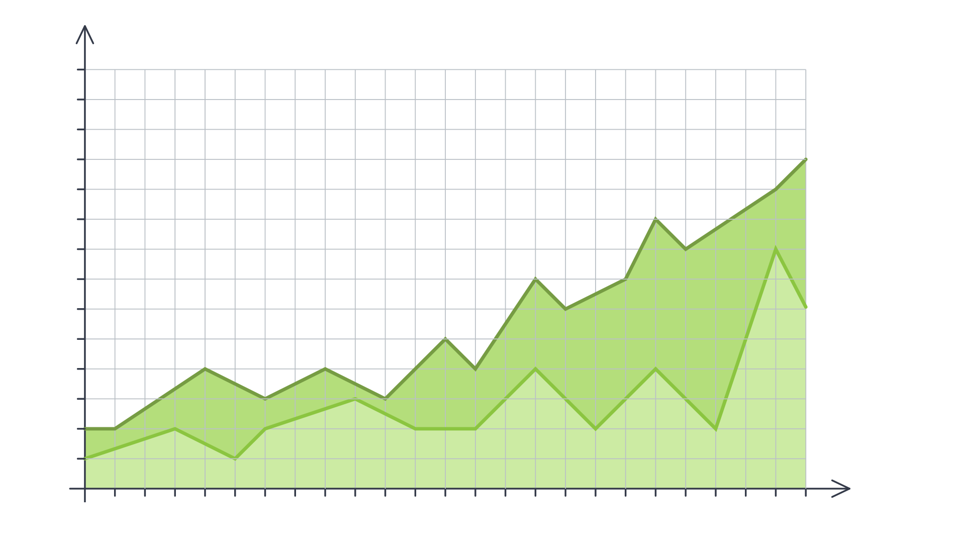


Data as Truth-Telling
Unearthing Relationships
Lung Cancer Deaths per 100,000
100k
95k
80k
85k
80k
75k
70k
65k
60k
55k
50k
45k
40k
35k
30k
25k
20k
1900
1901
1902
1903
1904
1905
1906
1907
1908
1909
1909
1910
1911
1912
1913
1914
1915
1916
1917
1918
1919
1920
Lung Cancer Deaths
Cigarettes Smoked

Slide 9
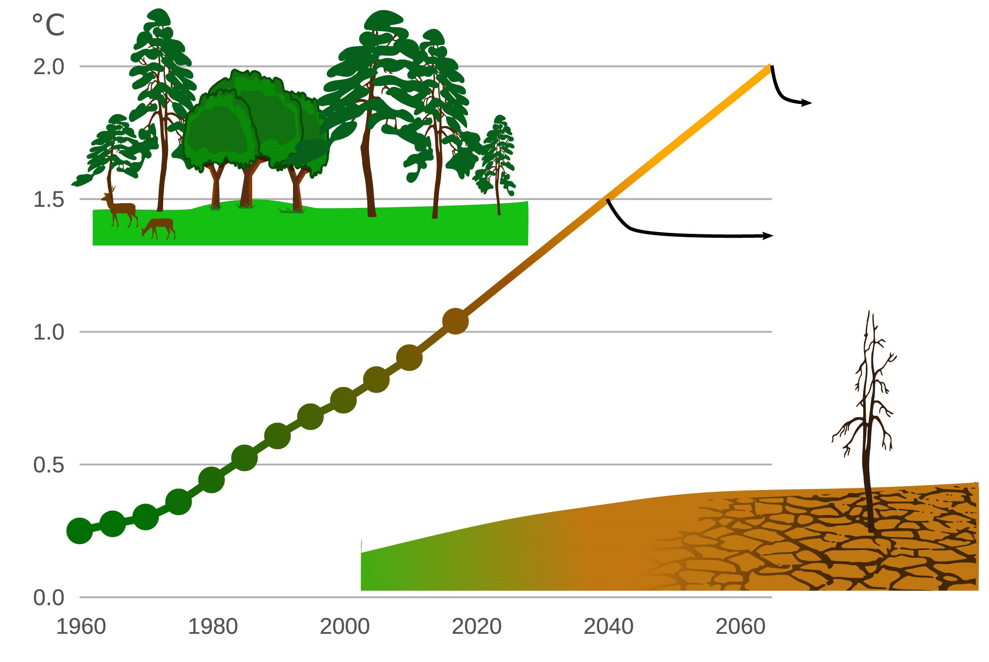
Data as Truth-Telling
Stating Significance
Exposure to Extreme Drought Is Increasing
190 million people
114 million people
Image Source: Exposure to Extreme Drought is Increasing

Slide 10
Course Plan

Slide 11
Lecture
BUSINESS INTELLIGENCE CONCEPTS, TABLEAU DESKTOP , CONCEPTS AND OPTIONS WHEN CONNECTING TO DATA IN TABLEAU
ANALYZE DATA USING TABLEAU , Filtering, sorting, and grouping
BUILDING INTERACTIVE DASHBOARDS AND STORY IN TABLEAU , MICROSOFT POWER BI INTRODUCTION, POWER QUERY FOR DATA TRANSFORMATION
DATA MODELING , REPORTS , VISUALIZATION IN POWER BI
DASHBOARD IN POWER BI, PUBLISHING REPORT
PROJECT PRESENTATION

Slide 12

Embrace your inner toddler.

Slide 13

Brace yourself for doubt, challenge, and confusion.

Slide 14

There is no shortcut.
You’ve got to put in the hours!
Notes:
shutterstock_643629568

Slide 15

Form a community with your classmates.

Slide 16

Enjoy the novice experience and expect a lot of lightbulb moments.

Slide 17

Celebrate your successes!

Slide 18



Choosing a Project Track
This project gives you the ability to focus your efforts within a specific industry.
Here are the specializations:
Finance
Healthcare
Custom

Slide 19

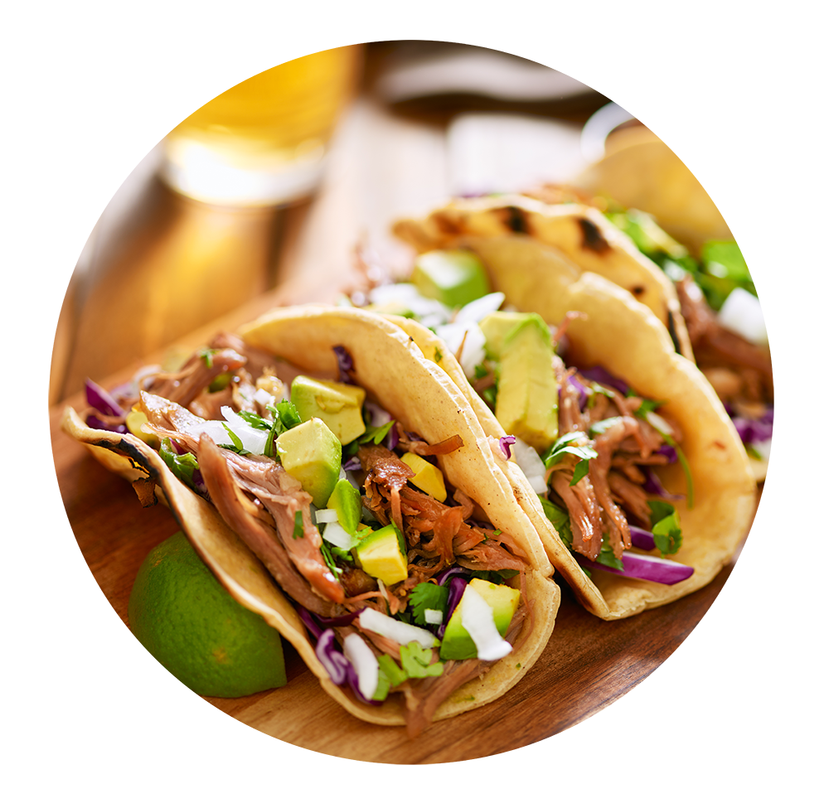

Group Activity: The Great Debate
Which food do Americans prefer:
Italian or Mexican food?

Slide 20

Analyze for Trends (Ratings)
Yelpers rate Italian and Mexican relatively equally.
4.0
3.5
3.0
2.5
2.0
1.5
1.0
0.5
0.0 | Mexican | Italian
Yelp Ratings by Food Variety
=
Average Rating
Food Variety
www.yelp.com

Slide 21
Analyze for Trends (Ratings)
Yelpers seem to review significantly more Italian restaurants.
Yelp Ratings by Food Variety
600000
500000
400000
300000
200000
100000
0.0 | Mexican | Italian
Review Counts
Food Variety
www.yelp.com

Slide 22

Analyze for Trends (Statistical Analysis)
We have an intuitive sense that the numbers are close, but to quantify our intuition, we use a Student's t-test. After performing the t-test, we can quantifiably state that the differences are not statistically significant
Metric | Italian | Mexican | p-value (t-test)
Average Rating | 3.806 | 3.826 | 0.284
Review Counts | 573k | 476k | 0.057
The difference in review counts is not statistically significant.

Slide 23
Analyze for Trends (Winner Take All)
Just for fun, let’s throw in an analysis that aggregates the data from all cities using a winner-take-all approach.
It’s sort of a wash.
 | # of Cities with Preference by Food Variety According to Rating
300
250
200
150
100
50
0 | Mexican | Italian
 | Food Variety
 | # of Cities with Preference by Food Variety According to Review Counts
300
250
200
150
100
50
0 | Mexican | Italian
 | Food Variety
# of Cities
# of Cities
www.yelp.com

Slide 24
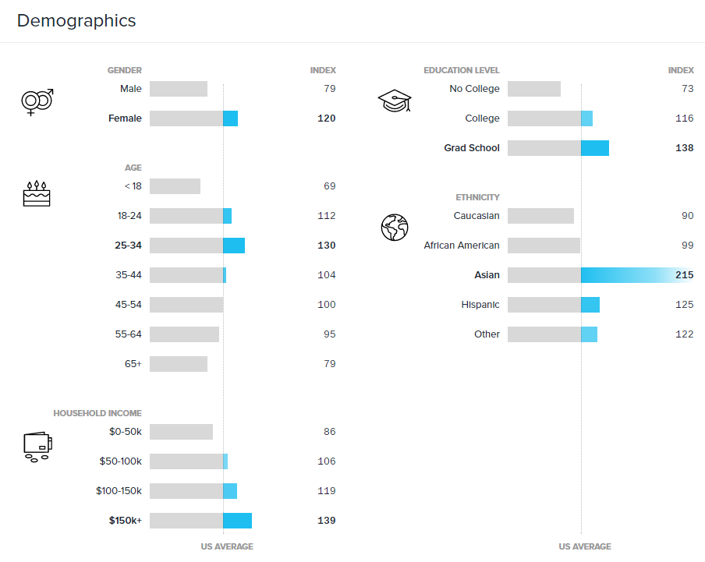
Limitations of Analysis
Yelp demographics may not match the American demographic.
www.yelp.com

Slide 25

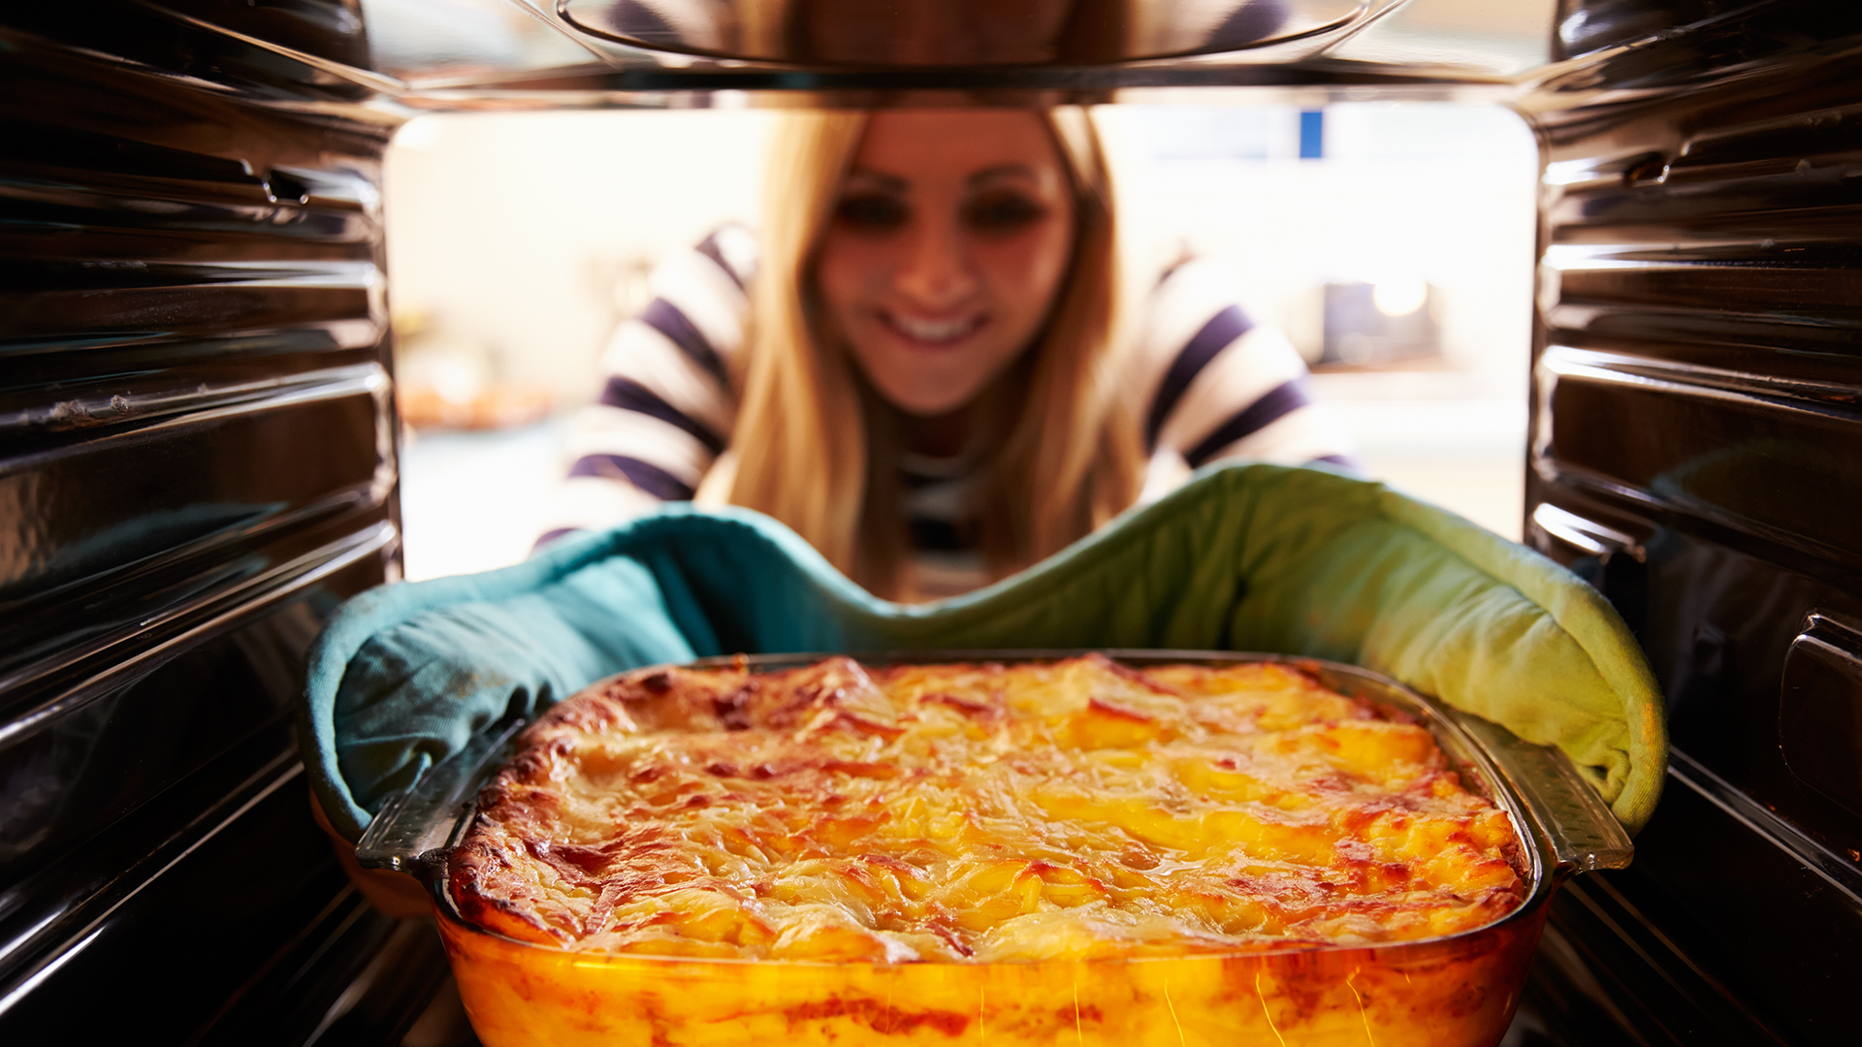
Limitations of Analysis
Restaurant experiences do not equate to home-cooked meals.

Slide 26

Limitations of Analysis
Fine-dining effect?

Slide 27


